Slide 1
Hot Glue Jellyfish Card
Cut-out element tips
Print on different-color cardstock and tape/glue to main card.
Fold along dotted lines.
Main card tips
Fold on dotted lines so print is inside card.
Cut out jellyfish outline.
Cover jellyfish opening with vellum. Tape or glue around outline so glue won’t leak.
Draw inside lines onto vellum.
From the front of the card, squeeze hot glue onto the vellum.

Slide 2
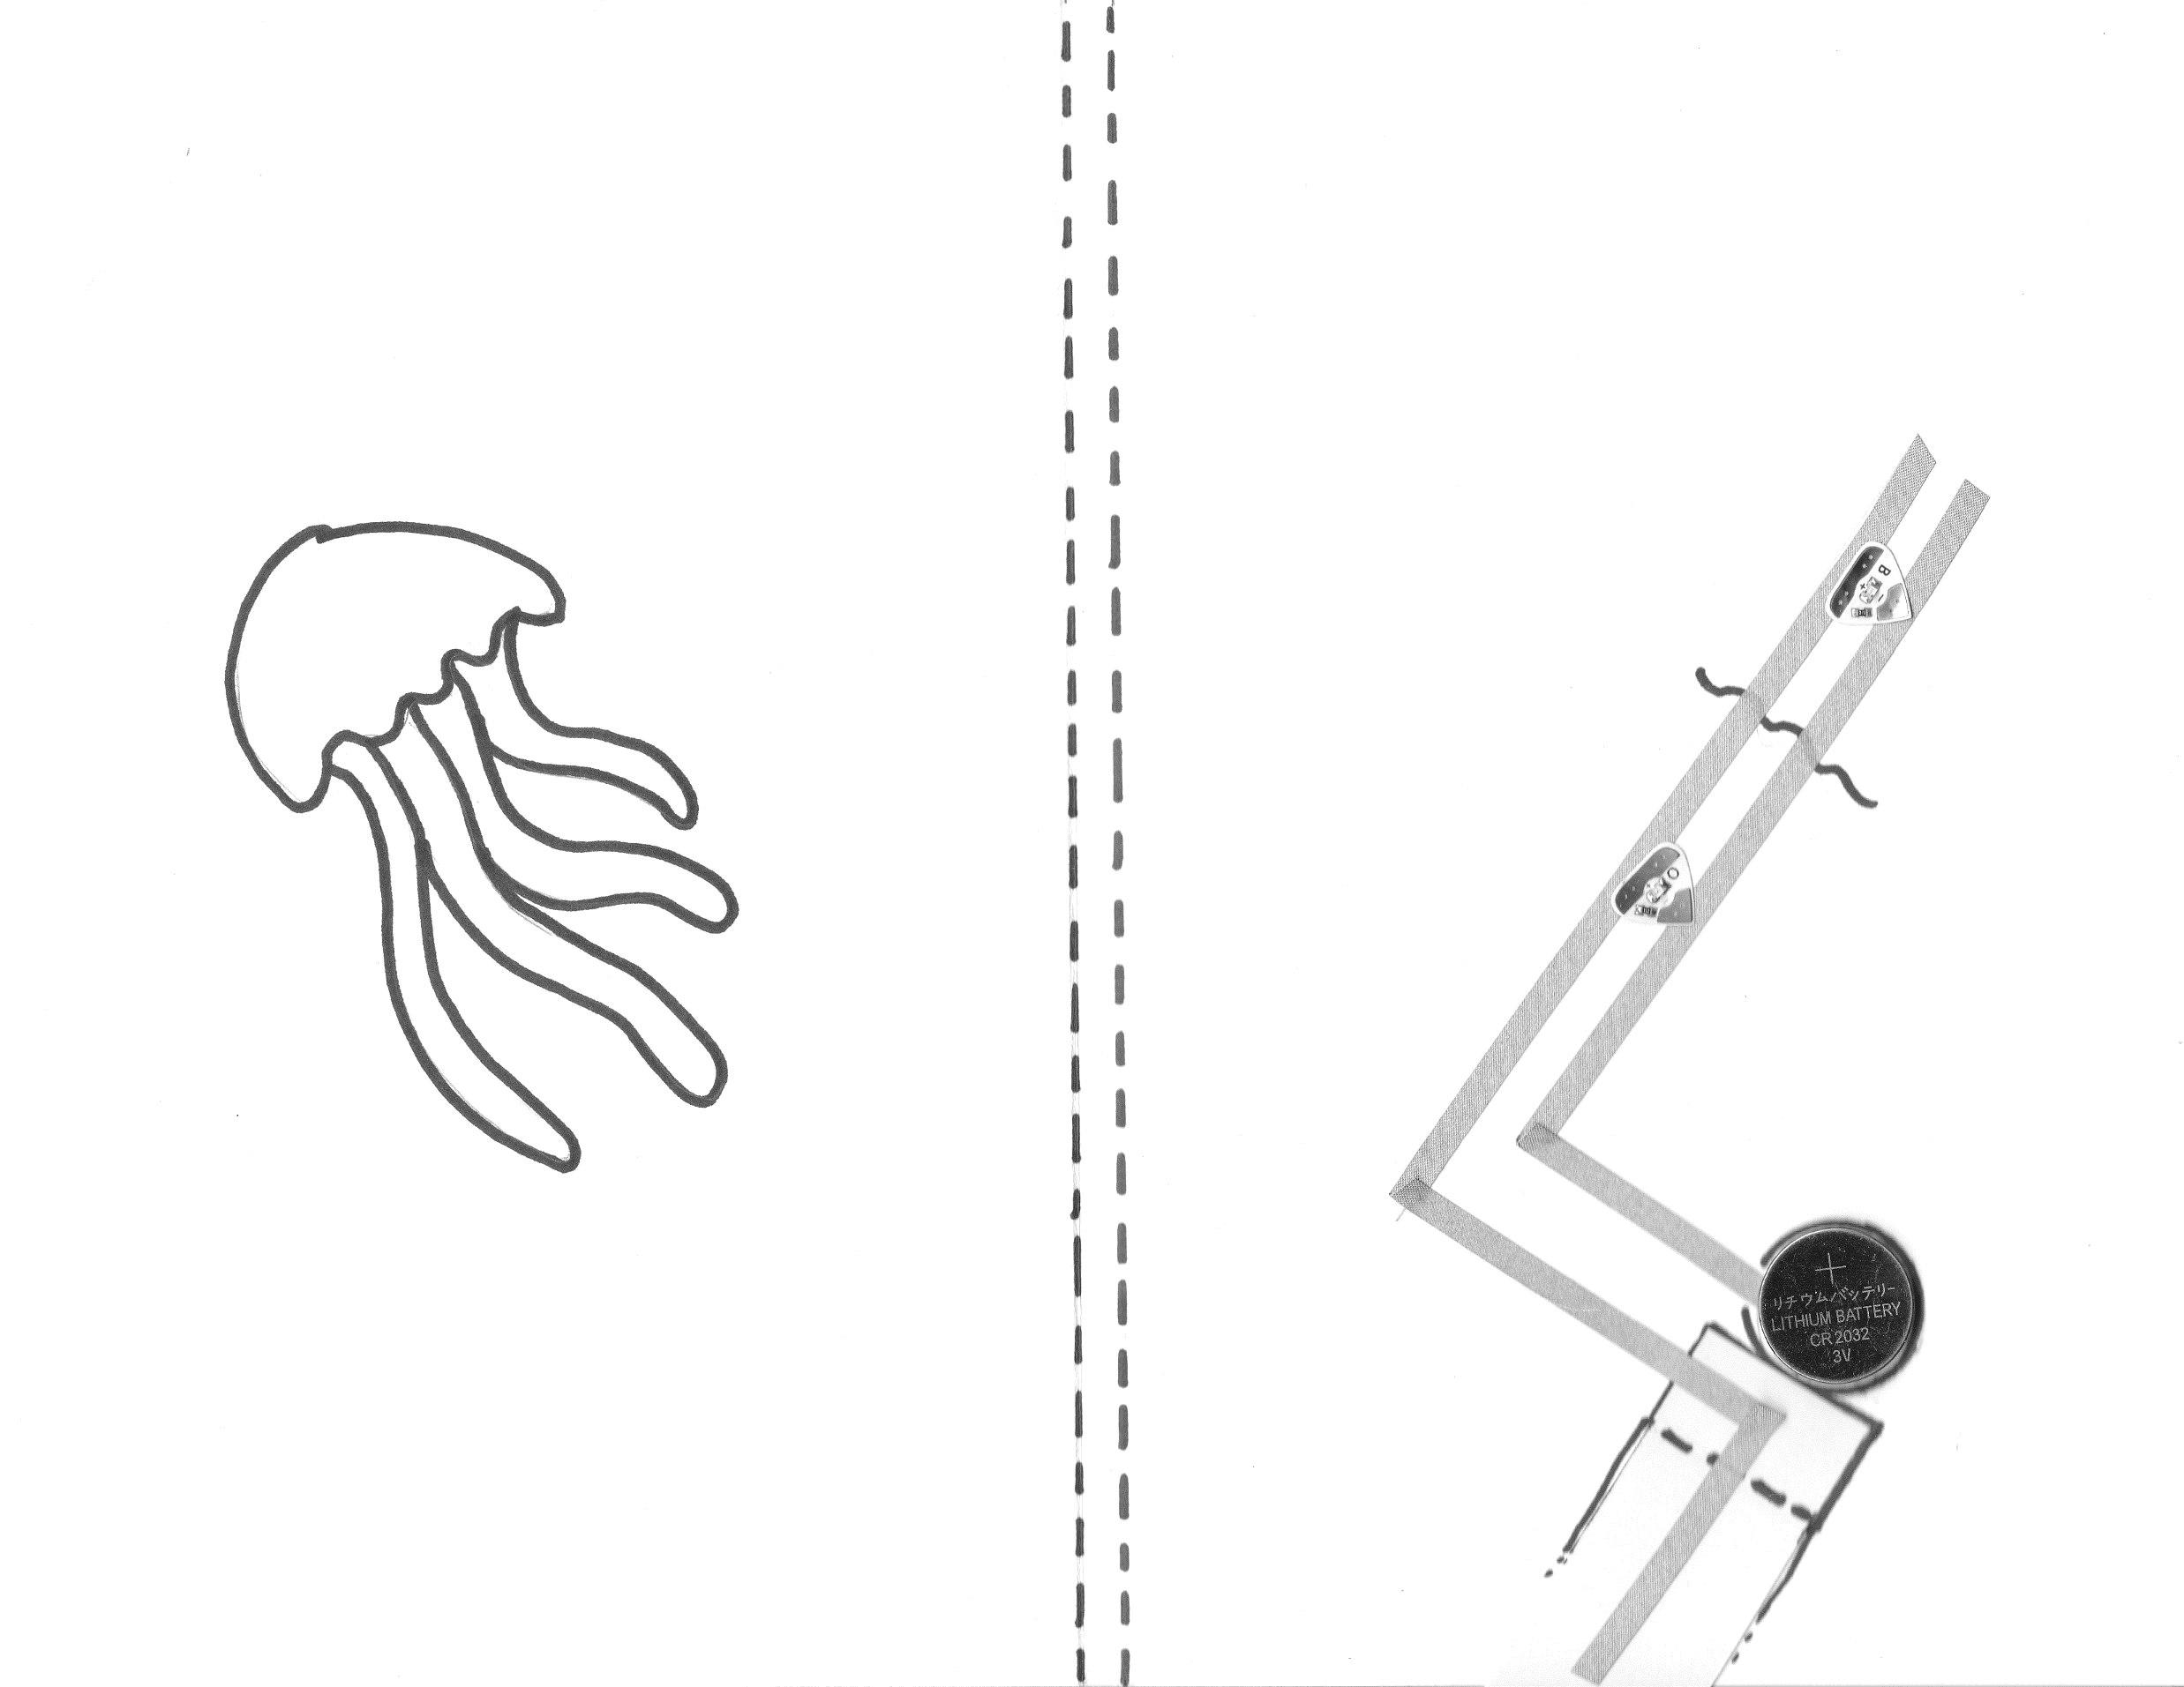
micro:bit Musical Cake Card with Chibitronics LED Stickers

Slide 3
micro:bit Musical Cake Card with Chibitronics LED Stickers

Slide 4
Hot Glue Jellyfish Card

